Slide 1
PHY2004: Electromagnetism and Optics
Principles of Laser
Textbooks
1. Lasers: foundation and applications, K. Thyagarajan, Chap.4-5.
2. Fundamentals of light sources and lasers, Mark Csele
Chap.4-6

Slide 2
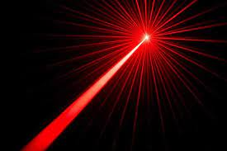
Laser
Laser is a special light source developed from quantum theory that has extraordinary properties not possessed by natural light sources, including (not limited to)
Monochromatic
Highly collimated
Coherent
High intensity

Slide 3
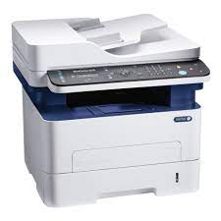
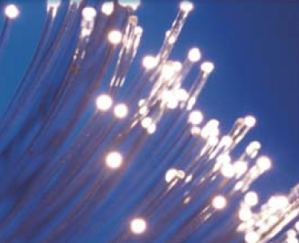
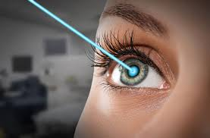
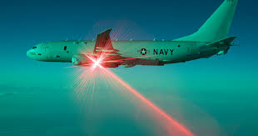
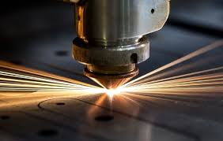
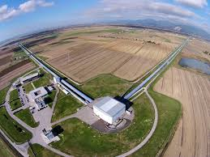
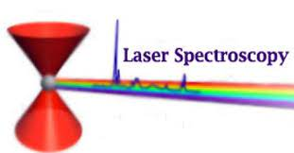
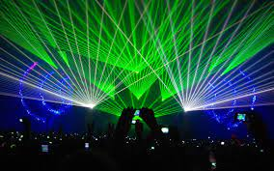
Applications of Laser

Slide 4
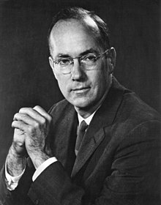
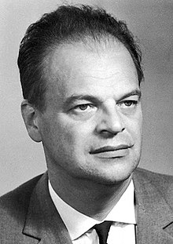
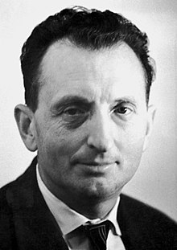
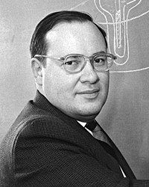
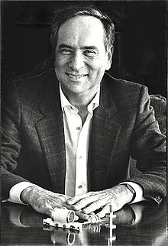
History of Laser
LASER: Light Amplification by Stimulated Emission of Radiation
MASER: Microwave Amplification by Stimulated Emission of Radiation
Year Name Development
1917 Einstein Quantum mechanics of radiation
1953 Townes, Gordon, Zeiger Built first MASER
1954 Townes et al First publication
Prokhorov, Basov Publication and assembled MASER
1958 Townes and Schawlow Proposal of Laser
1960 Maiman First working laser
1964 Townes, Basov, Prokhorov Nobel Prize in Physics
Townes
Basov
Prokhorov
Schawlow
Maiman

Slide 5
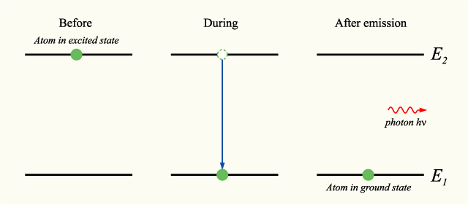
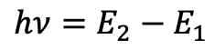
Spontaneous Emission
$$hν=E_{2}−E_{1}$$
According to quantum theory, atoms can possess a range of discrete energy levels. When an atom at higher energy level transits to a lower energy level, it emits (not always happen, it could transit back to a lower energy level without emitting photons, called nonradiative decay) a photon with energy equal to the difference between the two energy levels. This is called spontaneous emission process.

Slide 6
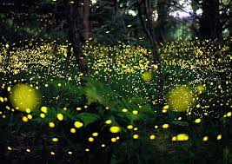

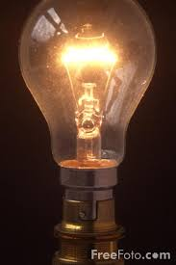
Spontaneous Emission
Spontaneous emission is responsible for most natural light sources, such as fireflies, candles, incandescent light bulbs, and many luminescence phenomena (such as electroluminescence, chemiluminescence, photoluminescence etc).
The phase and direction of spontaneous emission are random, so is incoherent and divergent.
Generally it involves a large collection of atoms with wide distribution of energy levels, so the emission spectrum is broad.

Slide 7

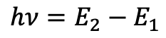
Stimulated Emission
$$hν=E_{2}−E_{1}$$
$$hν=E_{2}−E_{1}$$
An incoming photon with energy equal to the difference between the high and low energy states can ‘stimulate’ the atom to transit back to the low energy state and emit a photon with identical energy, polarization, phase and propagation direction as the incoming photon. The incoming photon is unaffected. This process is called stimulated emission. This was first theoretically developed by Einstein.

Slide 8


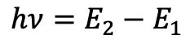
Absorption
Before
After
$$E_{2}$$
$$hν=E_{2}−E_{1}$$
$$E_{1}$$
An incoming photon is absorbed by an atom at the groud state, pumping the atom to a higher energy state. The energy of the photon is equal to the energy difference between the high and ground state. This process is called absorption.

Slide 9
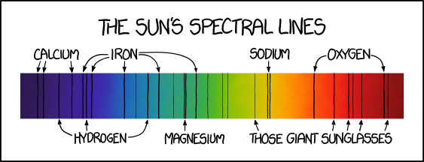
Absorption Spectrum
https://en.wikipedia.org/wiki/Fraunhofer_lines
Each element in the Periodic Table has its own unique absorption spectrum. This can be used to identify the elemental composition in the gases of stars. The spectrum shown above is called Fraunhofer lines, which is the optical absorption spectrum of sun.

Slide 10
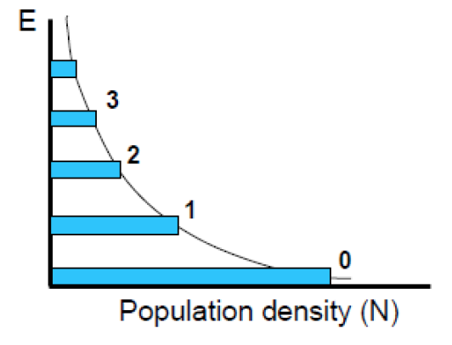
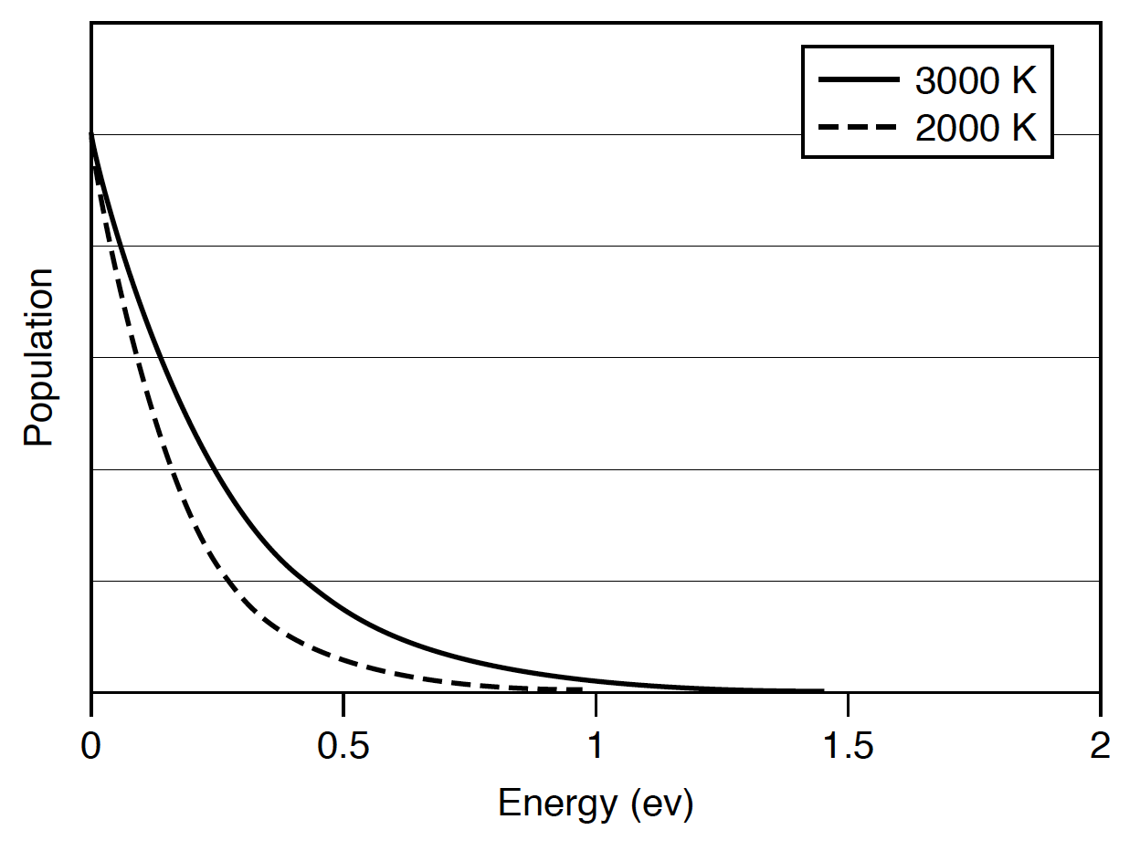
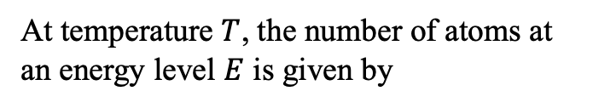
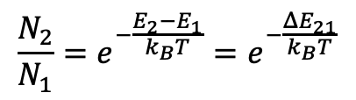
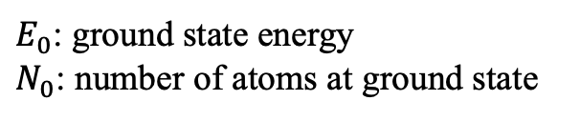
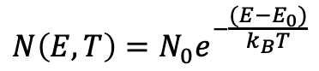
Population Distribution Law
At temperature $T$, the number of atoms at an energy level $E$ is given by
$$N\left(E, T\right)=N_{0}e^{−\frac{(E−E_{0})}{k_{B}T}}$$
$E_{0}$: ground state energy
$N_{0}$: number of atoms at ground state
The ratio of atom population between any two energy levels is
$$\frac{N_{2}}{N_{1}}=e^{−\frac{E_{2}−E_{1}}{k_{B}T}}=e^{−\frac{ΔE_{21}}{k_{B}T}}$$
Higher energy levels have less atoms
Population increases with temperature
Notes:
What about T=0?

Slide 11
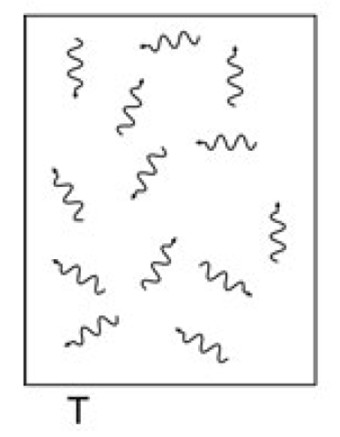
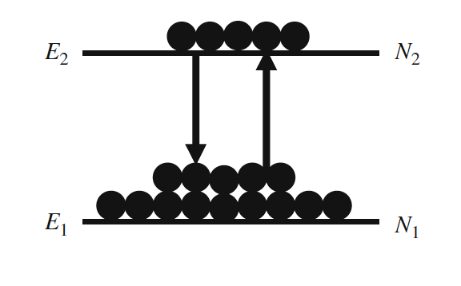
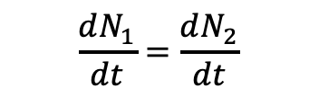
Einstein Coefficients
photon
atom
Spontaneous emission
absorption
Stimulated emission
Einstein considered a system composed of a collection of atoms sealed in a vessel. The system is at thermal equilibrium at temperature T. Absorption transports atoms from low energy level to high energy level, while spontaneous emission and stimulated emission processes transport atoms back from high energy level to low energy level. As the system is at thermal equilibrium, at any time, the change rate of atom population at energy level 1 must equal to the change rate of atom population at energy level 2.
$$\frac{dN_{1}}{dt}=\frac{dN_{2}}{dt}$$

Slide 12
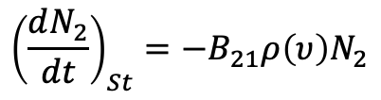
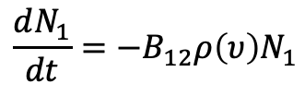
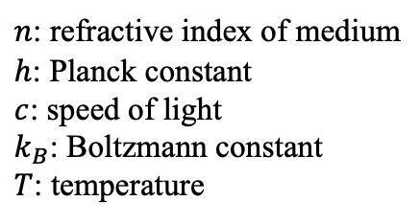
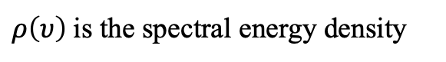
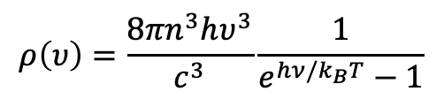
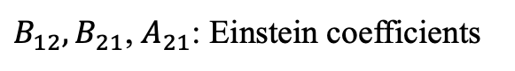
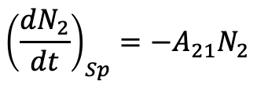
Einstein Coefficients
Absorption rate
$$\frac{dN_{1}}{dt}=−B_{12}ρ\left(υ\right)N_{1}$$
Spontaneous emission
absorption
Stimulated emission
Stimulated emission rate
$${\left(\frac{dN_{2}}{dt}\right)}_{St}={−B}_{21}ρ\left(υ\right)N_{2}$$
For the case of blackbody radiation, according to Planck’s law:
Spontaneous emission rate
$${\left(\frac{dN_{2}}{dt}\right)}_{Sp}=−A_{21}N_{2}$$
$$ρ\left(υ\right)=\frac{8πn^{3}hυ^{3}}{c^{3}}\frac{1}{e^{hν/k_{B}T}−1}$$
$n$: refractive index of medium
$h$: Planck constant
$c$: speed of light
$k_{B}$: Boltzmann constant
$T$: temperature
$B_{12}, B_{21}$, $A_{21}$: Einstein coefficients
$ρ\left(υ\right)$is the spectral energy density

Slide 13
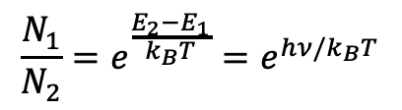
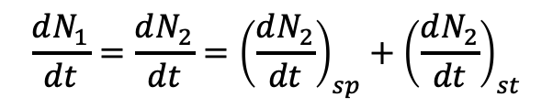
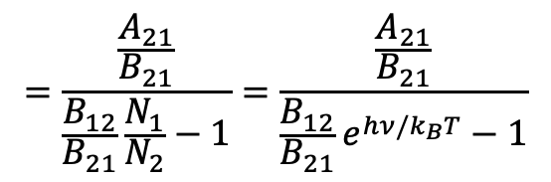
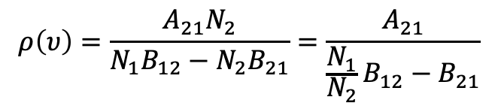
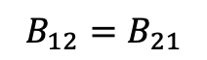
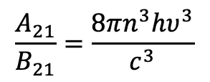
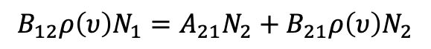
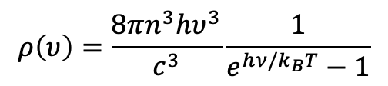
Einstein Coefficients
Thermal equilibrium condition requires:
$$ρ\left(υ\right)=\frac{8πn^{3}hυ^{3}}{c^{3}}\frac{1}{e^{hν/k_{B}T}−1}$$
$$\frac{dN_{1}}{dt}=\frac{dN_{2}}{dt}={\left(\frac{dN_{2}}{dt}\right)}_{sp}+{\left(\frac{dN_{2}}{dt}\right)}_{st}$$
(2)
Comparing (1) and (2), we obtain
$$B_{12}ρ\left(υ\right)N_{1}=A_{21}N_{2}+B_{21}ρ\left(υ\right)N_{2}$$
$$B_{12}=B_{21}$$
$$ρ\left(υ\right)=\frac{A_{21}N_{2}}{N_{1}B_{12}−N_{2}B_{21}}=\frac{A_{21}}{\frac{N_{1}}{N_{2}}B_{12}−B_{21}}$$
Einstein coefficients of absorption and stimulated emission are identical. Absorption is the reverse process of stimulated emission.
$$=\frac{\frac{A_{21}}{B_{21}}}{\frac{B_{12}}{B_{21}}\frac{N_{1}}{N_{2}}−1}=\frac{\frac{A_{21}}{B_{21}}}{\frac{B_{12}}{B_{21}}e^{hν/k_{B}T}−1}$$
(1)
$$\frac{A_{21}}{B_{21}}=\frac{8πn^{3}hυ^{3}}{c^{3}}$$
$$\frac{N_{1}}{N_{2}}=e^{\frac{E_{2}−E_{1}}{k_{B}T}}=e^{hν/k_{B}T}$$

Slide 14
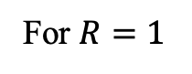
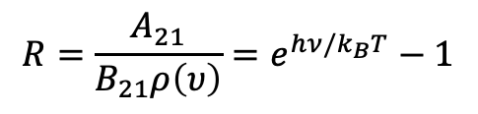
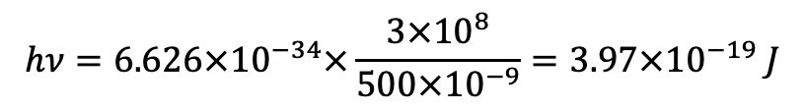
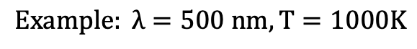
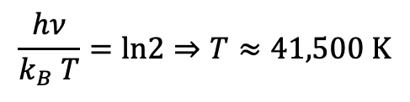
Spontaneous Emission vs Stimulated Emission
Ratio between spontaneous emission and stimulated emission
For $R=1$
$$\frac{hν}{k_{B} T}=ln2⇒T≈41,500 K$$
$$R=\frac{A_{21}}{B_{21}ρ\left(υ\right)}=e^{hν/k_{B}T}−1$$
$$Example: λ=500 nm, T=1000K$$
In normal circumstances, light emission is dominated by spontaneous emission, hence light from natural sources mostly originates from spontaneous emission process, with random phase, direction, and broad line width.
$$hν=6.626×{10}^{−34}×\frac{3×{10}^{8}}{500×{10}^{−9}}=3.97×{10}^{−19} J$$
$k_{B} T=1.38×{10}^{−23}×1000=1.38×{10}^{−20} J$
$$R=e^{hν/k_{B}T}−1≈e^{28.7}≈3.16×{10}^{12}$$

Slide 15






Light Amplification
$$I$$
$$I+dI$$
$$z$$
$$z+dz$$
The increased light intensity $dI$after travelling a distance $dz$ in the lasing medium is determined by the difference of stimulated emission and absorption, given by
$${dI∝[B}_{21}ρ\left(υ\right)N_{2}−B_{12}ρ\left(υ\right)N_{1}]=B_{12}ρ\left(υ\right)(N_{2}−N_{1})$$
To have amplification of light intensity, it requires $dI>0$ , however, generally $N_{2}<N_{1}$, so $dI<0$. This means in normal circumstances light is absorbed rather than amplified. To achieve amplification, we need $N_{2}>N_{1}$, so called population inversion.

Slide 16






Lifetime
$$E_{2}$$
Radiative decay
Non-radiative decay
$$γ_{nr}$$
$$γ_{r}$$
$$E_{1}$$
Atoms can stay at excited energy states for a short time. They will transit back to the ground state either by emitting a photon which is called radiative decay or without emitting a photon which is called non-radiative decay. The lifetime $τ$ of atoms at an excited state is inversely proportional to the total decay rate (sum of radiative decay rate $γ_{r}$ and the non-radiative decay rate $γ_{nr}$).
$$τ=\frac{1}{γ_{r}+γ_{nr}}$$

Slide 17







Population Inversion
3-level lasing system
$$γ_{32}$$
$$γ_{13}$$
$$γ_{21}$$
$$hν=E_{2}−E_{1}$$
Population inversion can be achieved on a three energy-level system involving different lifetimes.
Atoms are pumped onto the highest level 3 with an absorption rate $γ_{13}$.
Atoms at level 3 quickly relax to level 2 without emitting photons with a decay rate $γ_{32}$.
Atoms at level 2 transit to the ground state much more slowly with a decay rate $γ_{21}$.
Under the condition $γ_{32}≫γ_{13}≫γ_{21}$, or lifetime${ τ}_{32}≪τ_{13}≪τ_{21}$, more atoms will be accumulated at energy level 2 than at the ground state, achieving population inversion between level 2 and level 1.
Lasing happens between level 2 and the ground state through stimulated emission, emitting photons of energy $hν=E_{2}−E_{1}$.

Slide 18


The First Laser
Ruby: Alumina (Al₂O₃) doped with Chromium (~0.05 % by weight)
The world’s first laser invented by Maiman in 1960 in principle is a 3-level lasing system (though it involves more than three energy levels). Atoms at the ground state are pumped onto bands of excited states ($E_{1}$ and $E_{2}$), then quickly (~${10}^{−8}$s) transit to a metastable state ($M$). The transition from state $M$ to the ground state has a much longer lifetime (~$3$ ms), thus achieving population inversion. Lasing happens between state $M$ and the ground state with an emission wavelength of 694.3 nm.
Key characteristic of 3-level lasing system: lasing is between a metastable state and the ground state.
Disadvantage: requiring significant pumping power, as at least half of atoms at the ground state need to be pumped onto excited states.

Slide 19

Theodor Maiman
(1927-2007)

Slide 20


Four Level Lasing System
$${hν=E}_{3}−E_{2}$$
Atoms at the ground state (level 1) are pumped to the highest level (level 4), which quickly relax to level 3 via nonradiative transition processes without emitting photons.
The transition from level 3 to level 2 is a slow process, so atoms are accumulated at level 3.
Transition from level 2 to level 1 is fast, so very few atoms remain at level 2, therefore achieving population inversion between level 3 and 2.
As the ground state is not involved in lasing, there is no need to pump at least >50% atoms as the case in a 3-level system, hence a 4-level system can be more efficient than a 3-level lasing system.

Slide 21




He-Ne Laser
$λ=$632.8 nm
A 4-level lasing system.
Mixture of He and Ne gas at a ratio of 10:1 (1 torr and 0.1 torr, respectively).
He atoms are excited to long lifetime (${10}^{−6}\sim {10}^{−4} s$) states F2, F3, which excite Ne atoms to E4, E6 states through collision.
Transition between E6 and E3 produces the emission of 632.8 nm laser line.
E3 to E2 is a fast process with lifetime of ~ ${10}^{−8}s$, much shorter than the lifetime of E6, so steady population inversion can be achieved between E6 and E3.

Slide 22

Structure of Laser
A laser has three basic elements:
A pump source: input energy to pump atoms from ground states to excited states. Common pumping techniques include optical pumping (flash lamp or other lasers) and particle pumping (through particle collision, mostly adopted in gas lasers)
A gain (lasing) medium
An optical resonator cavity: a pair of reflective mirrors to reflect laser beam back and forth inside the cavity many many times to increase the gain. One mirror is partially reflective to allow the output of some portion of energy.

Slide 23






Threshold Condition
$$α_{1}$$
After one complete round trip inside the resonator cavity, the intensity of the reflected beam after mirror 1 is enhanced by a factor of $R_{1}R_{2}e^{2\left(γ−α_{1}\right)d}$. For light amplification to happen, this factor needs to be greater than 1.
Example: A He-Ne laser, at 632.8 nm
Gain coefficient $γ=0.1/m$
Loss: 0.5% per round trip
$R_{1}≈R_{2}=99.9\%$
$$d=20 cm$$
$$R_{1}R_{2}e^{2\left(γ−α_{1}\right)d}≥1$$
$$R_{1}R_{2}e^{2\left(γ−α_{1}\right)d}≈1.013>1$$
Threshold condition for lasing

Slide 24





Longitudinal Cavity Mode
$$d$$
In order to have maximum amplification effect, the phase change of a complete round trip should be integer multiples of $2π$ so that light is constructively interfered. This means the cavity length should be multiples of half wavelength of light in the lasing medium.
$$d=n\left(\frac{λ_{max}}{2}\right)→λ_{max}=\frac{2d}{n}$$
$n$ is an integer,${ λ}_{max}$ is the wavelength of emission light inside the lasing medium that will have maximum amplification.

Slide 25




Longitudinal Cavity Mode
Longitudinal cavity modes
The frequencies of maximum amplification laser lines are
$$ν_{n}=\frac{c}{ηλ_{max}}=\frac{nc}{2ηd}$$
$η$: refractive index of lasing medium
Frequency separation:
$$∆ν_{sp}=ν_{n+1}−ν_{n}=\frac{\left(n+1\right)c}{2ηd}−\frac{nc}{2ηd}=\frac{c}{2ηd}$$
Constant frequency separation

Slide 26


Types of Lasers
Lasing medium and structure: gas laser, dye (liquid) laser, solid state laser, semiconductor laser, fiber laser, photonic crystal laser, surface plasmon laser, free electron laser
Gas laser: HeNe, CO₂ (up to hundreds of kilowatts, 9.6 and 10.6 $μm$), excimer lasers (F₂, ArF, KrCl, KrF, XeCl etc, UV light), Argon ion lasers (visible range).
Liquid laser: dye lasers (320-1200 nm, CW or pulsed, can be very powerful).
Solid state laser: ruby laser, Ti:Sapphire laser, Nd YAG laser
Free electron laser: very broad frequency range from teraHz to soft x-ray.
Mode of operation: continuous wave (CW) operation, pulsed operation

Slide 27
Properties of Lasers
Laser is a special light source developed from quantum theory that has extraordinary properties not possessed by natural light sources, including (not limited to)
Monochromatic
Highly collimated
Coherent
High intensity

Slide 28



Monochromaticity
Solar spectrum
Emission line of Ruby laser
~500 nm
~0.5 nm
Optical clock (⁸⁷Sr) | 4.292280042298734×10¹⁴
Laser emission is due to the transition between two discrete quantum states of well-defined energies, hence can have very narrow linewidth.
Today’s lasers can have linewidth < 1 Hz (corresponding to ~10⁻²¹ nm for visible light).
Applications: atomic clock, spectroscopy, interferometer etc
Optical clock (⁸⁷Sr), $υ=4.292280042298734×{10}^{14}$Hz
Accuracy~$1$ part in ${10}^{16}$

Slide 29



Directionality
Laser beams are highly directional with very small divergence.
Laser beam can travel a distance near the laser source almost without any divergence. This distance is given by $\frac{d^{2}}{λ}$, called Rayleigh range.
After the Rayleigh range, laser beam has a divergent angle $θ≈\frac{λ}{d}$, $d$is aperture or diameter of laser beam.
After traveling distance L, the beam diameter is $D≈2Lθ=\frac{2Lλ}{d}$
Example: $λ=632$ nm, $d=1$ mm, $L=1$km
Rayleigh range $=\frac{d^{2}}{λ}=1.58$ m, $θ≈\frac{λ}{d}=6.32×{10}^{−4}$ rad, $D=\frac{2Lλ}{d}=1.26$ m

Slide 30



Lunar Laser Ranging Experiment
Apollo 15 LRRR
Retroreflector
By sending pulsed laser shots to retroreflector installed on moon and measuring the round-trip time, the distance between moon and earth can be measured.
Beam size on moon ~ 2 km. Return beam size on earth ~15 km.
Accuracy up to millimeter for a distance of ~ 384,400 km, ~2 parts in 10¹².
Tests of gravitation physics and investigation of moon properties
Moon is moving away from earth at a rate of 3.8 cm/yr
Moon probably has a liquid with radius of ~ 350 km
Gravitation constant change rate $\frac{dG}{dt}/G$ <10⁻¹²/yr

Slide 31




Coherence
Coherence is an important property of waves, which quantifies the correlation between physical quantities of a single wave, or between several waves or wave packets.
Two waves are coherent if the fields have definite phase difference.
$$E_{1}=A_{1}e^{iφ_{1}}$$
$$E_{2}=A_{2}e^{iφ_{2}}$$
$$∆φ=φ_{2}−φ_{1}$$
Coherent: $∆φ$ has a definite value, $φ_{1}$ and $φ_{2}$ are corelated
Incoherent: $∆φ$ is random, $φ_{1}$ and $φ_{2}$ are unrelated
When two waves meet, the total electric field is the sum of the electric fields of the two waves
$${E=E}_{1}+E_{2}=A_{1}e^{iφ_{1}}+A_{2}e^{iφ_{2}}$$

Slide 32




Intensity
Intensity
$$I=\left\langle EE^{∗}\right\rangle =\left\langle \left(A_{1}e^{iφ_{1}}+A_{2}e^{iφ_{2}}\right)\left(A_{1}e^{−iφ_{1}}+A_{2}e^{−iφ_{2}}\right)\right\rangle$$
$$=A_{1}^{2}+A_{2}^{2}+A_{1}A_{2}\left(\left\langle e^{i(φ_{1}−φ_{2})}\right\rangle +\left\langle e^{i(φ_{2}−φ_{1})}\right\rangle \right)$$
$$I_{1}=A_{1}^{2},I_{2}=A_{2}^{2}$$
$$=I_{1}+I_{2}+A_{1}A_{2}\left(\left\langle e^{i(φ_{1}−φ_{2})}\right\rangle +\left\langle e^{i(φ_{2}−φ_{1})}\right\rangle \right)$$
Incoherent waves: $φ_{1}−φ_{2}$ is unrelated.
$$\left\langle e^{i(φ_{1}−φ_{2})}\right\rangle =\left\langle e^{i(φ_{2}−φ_{1})}\right\rangle =0$$
$$I_{incoherent}=I_{1}+I_{2}$$
Coherent waves: $φ_{1}−φ_{2}=δ$ is a definite value.
$$\left\langle e^{i(φ_{1}−φ_{2})}\right\rangle +\left\langle e^{i(φ_{2}−φ_{1})}\right\rangle =2\cos{δ}$$
$$I_{coherent}=I_{1}+I_{2}+2\sqrt{I_{1}I_{2}}\cos{δ}$$
$I_{max}=I_{1}+I_{2}+2\sqrt{I_{1}I_{2}}$, when $δ=0$, constructive interference
$I_{min}=I_{1}+I_{2}−2\sqrt{I_{1}I_{2}}$, when $δ=π$, destructive interference

Slide 33






Interference
$$I_{1}$$
$${I=I}_{1}+I_{2}$$
$$I_{2}$$
When two incoherent beams meet, the total intensity is the sum of the intensity of two individual beams.
Incoherent light source
When two coherent beams meet, the total intensity is dependent on the phase difference between the two beams, forming interference fringes.
Coherent light source
Double slits experiment

Slide 34





Coherence Length and Time
Coherence length: the propagation distance of a coherent wave over which it maintains a specified degree of coherence
$$L_{c}=\frac{λ^{2}}{Δλ}$$
$Δλ$: linewidth of laser
If the path difference of the two beams in an interferometer is longer than the coherence length, the visibility of interference fringes will degrade.
Coherence time: the time elapse over which a coherent wave maintains a specified degree of coherence
Examples:
He-Ne laser $λ=632.8$nm, $Δλ≈0.001$ nm, $L_{c}≈40$ cm
Sun light: $λ≈500$nm, $Δλ≈500$ nm, $L_{c}≈500$ nm
$$T_{c}=\frac{L_{c}}{c}=\frac{λ^{2}}{cΔλ}$$

Slide 35

LIGO
Laser Interferometer Gravitational-Wave Observatory (LIGO)
Gravitation waves are expected to distort the 4 km mirror spacing by ~ 10⁻¹⁸ m. This will induce a phase difference between the two beams.
To increase the phase difference, high power laser (808nm) is reflected forth and back for 280 round trips in each of the 4 km arm before merging in the detector, equivalent to a distance of 1120 km.
Initially the two beams were tuned to be out of phase at the photodetector, so no signal was recorded.
When gravitation waves arrive, it distorts the space, the two beams are not out-of-phase anymore, so the photodetector will record some signals.
On 11 February 2016, first observation of gravitation waves was announced, due to the merge of two black holes.
In 2017, Nobel Prize in Physics was awarded to Weiss, Thorne and Barish for ‘decisive contributions to the LIGO detector and the observation of gravitational waves’.

Slide 36






High Power
$$α_{1}$$
The amplification after one round trip
Up to 100s kW cw lasers are commercially available
US navy developed a Mid-Infrared Advanced Chemical Laser (MIRACL) with output cw power over megawatts, $λ=$3.8 $μ$m, over 70s duration.
EU’s Extreme Light Infrastructure (ELI) project develops pulsed laser with peak power up to 10 PW (10,000,000,000,000,000 Watt). Pulse duration: ~24 fs.
$$g=R_{1}R_{2}e^{2\left(γ−α_{1}\right)d}>1$$
After $N$ round trips, intensity
$$I=I_{0}g^{N}$$
If only $g$ and $N$ are large enough, the power can be very high

Slide 37



Applications of High Power Lasers
Applications of high power laser
Industrial application: cutting, welding, materials processing
Surgery
Plasma physics
Nuclear Fusion
Military
Laser fusion
National Ignition Facility
192 pulsed lasers, 1.9 MJ, <4 ns

Slide 38

Laser Safety
Due to the high power and low divergency of beam, lasers can potentially cause significant damages to eyes and even skins.

